Slide 1

Introduction to Holistic Management Whole Farm/Ranch Planning
Improve Results on Your Farm or Ranch

Slide 2
Holistic Management
Holistic Management® is a whole farm planning system designed to:
Help you better manage your land
Achieve sustainable environmental, economic, and social objectives
Ensure you consider what you value most deeply
Make decisions that move you toward what you desire for your farm, your family, and your life
Notes:
Don’t show until after group discusses

Slide 3
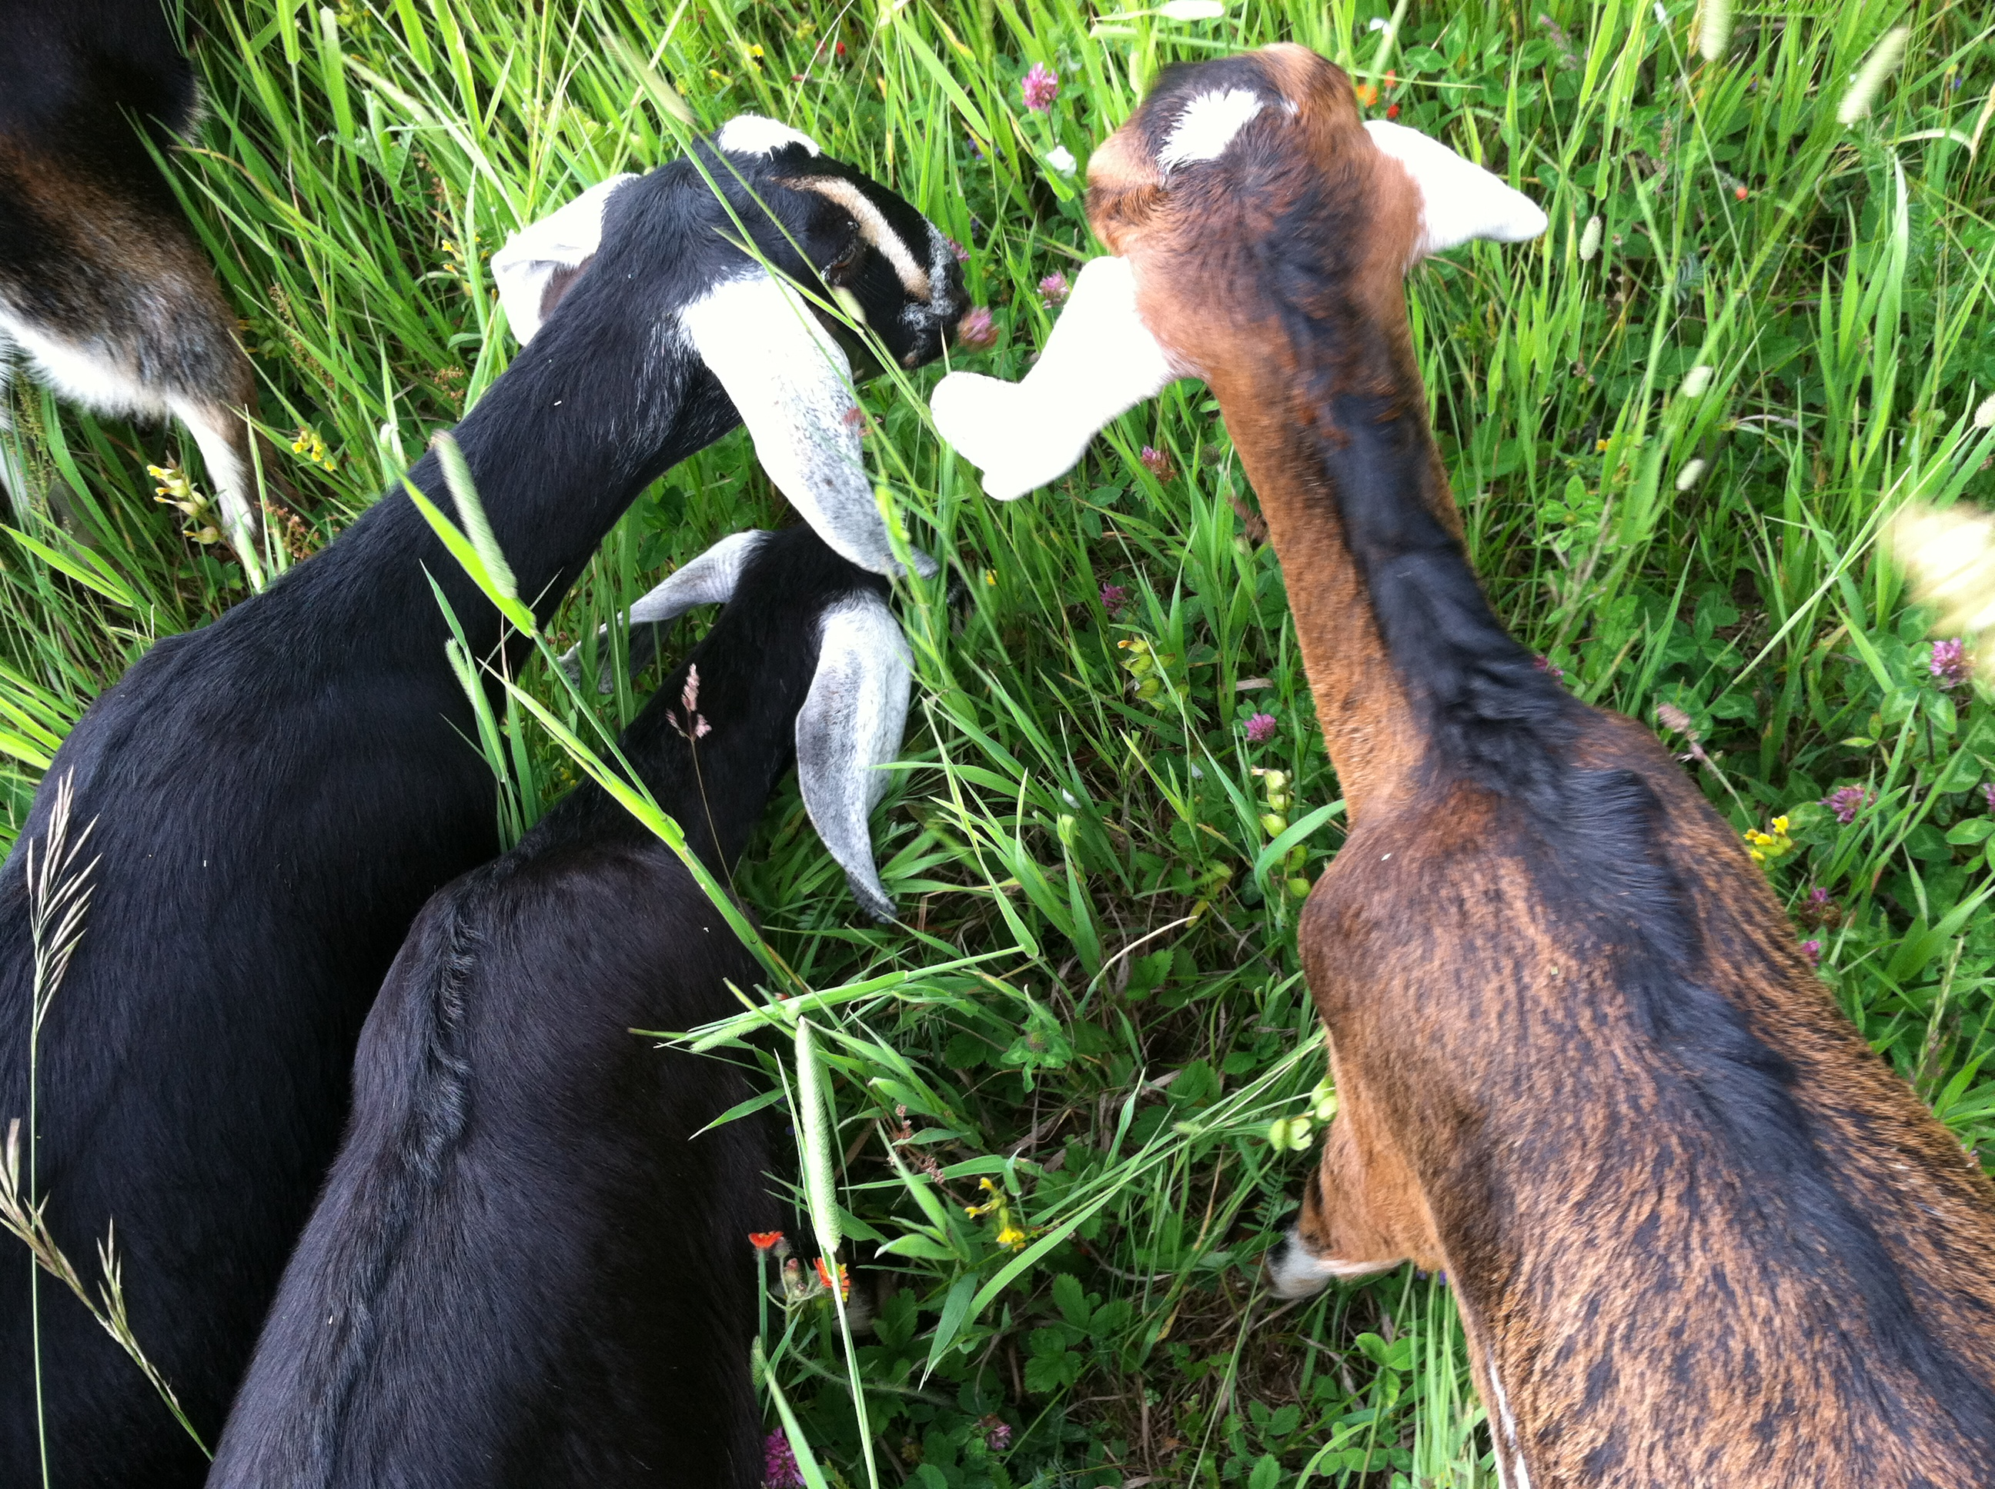
Holistic Management Principles
Nature functions in wholes
Understand your environment
Notes:
Refer to framework on page 1·4 and poster on wall
(Principles are also written on the Tree poster, Summary of Practices)
These two principles are the foundation of Holistic Management-
Describe first principle
TRANSITION to next slide – Let’s look at a specific example. It is also in your handout on page 1·5.

Slide 4
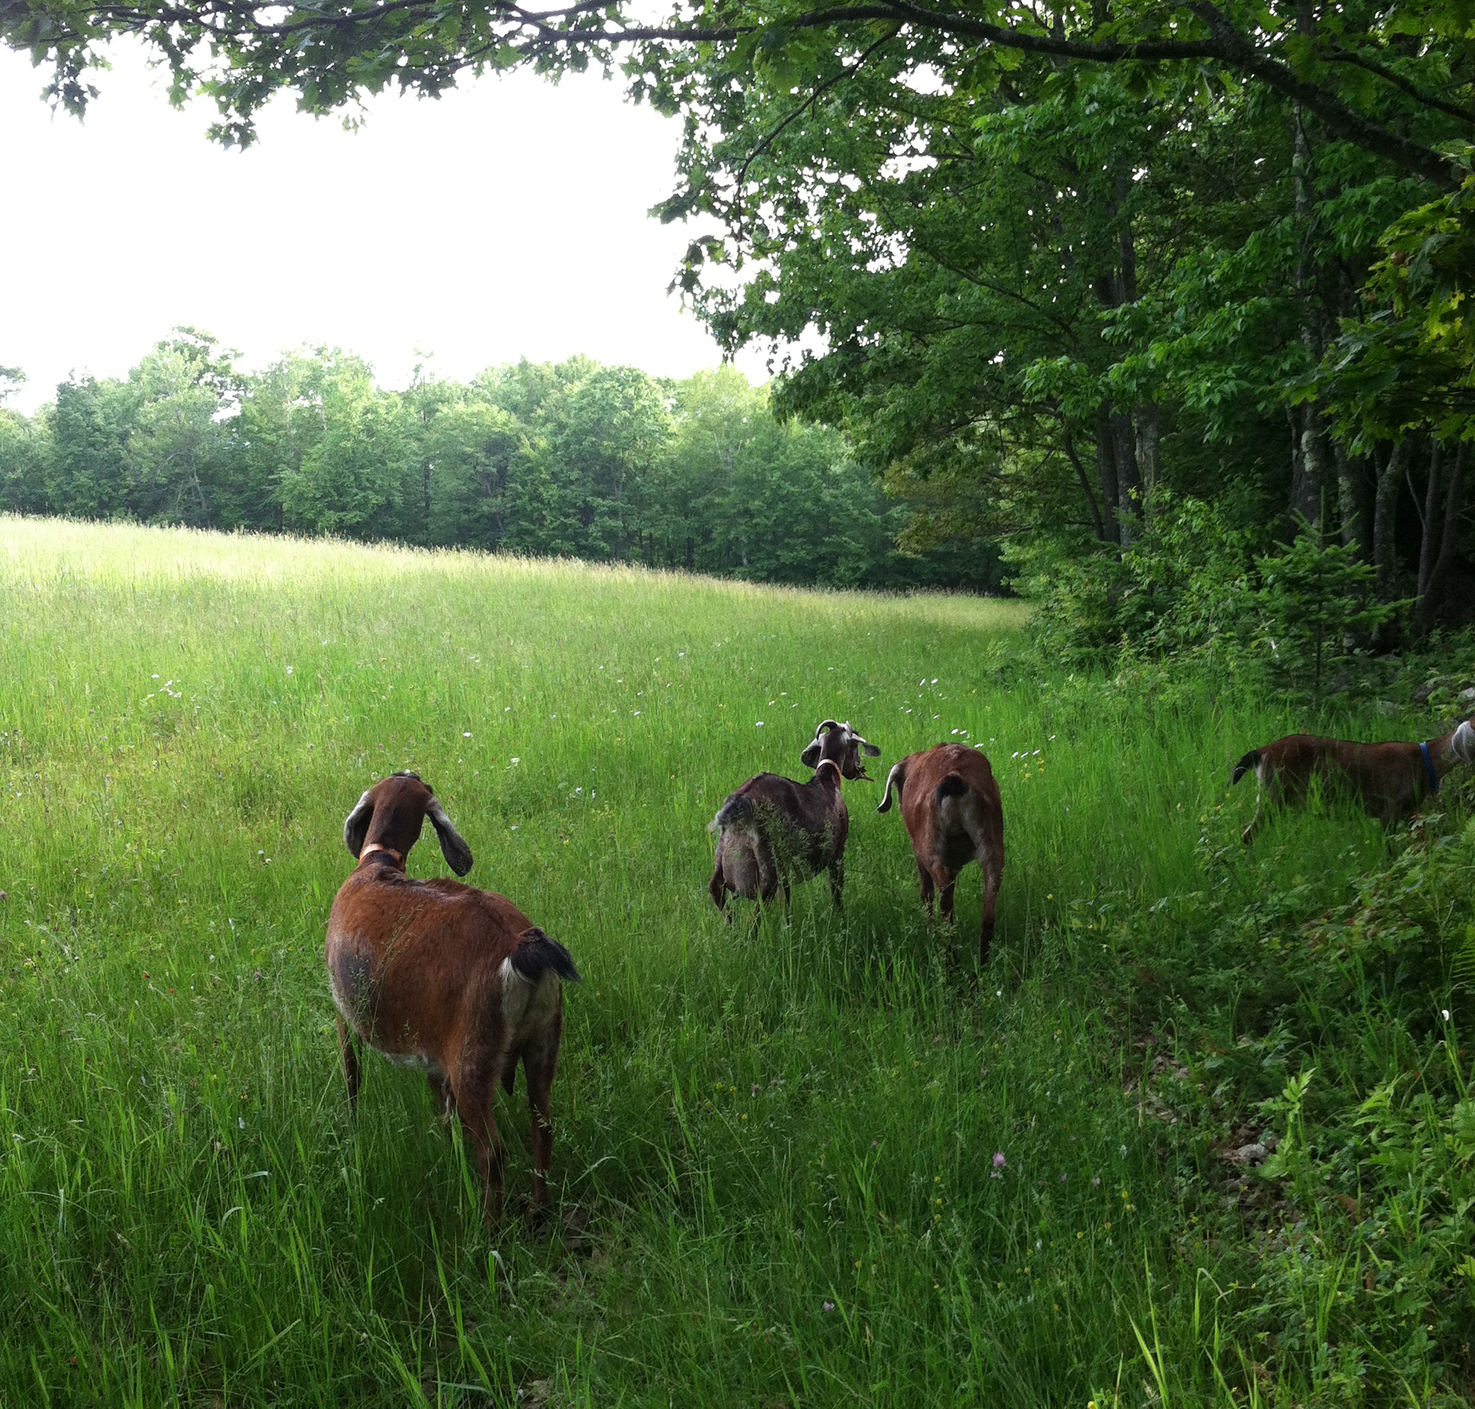
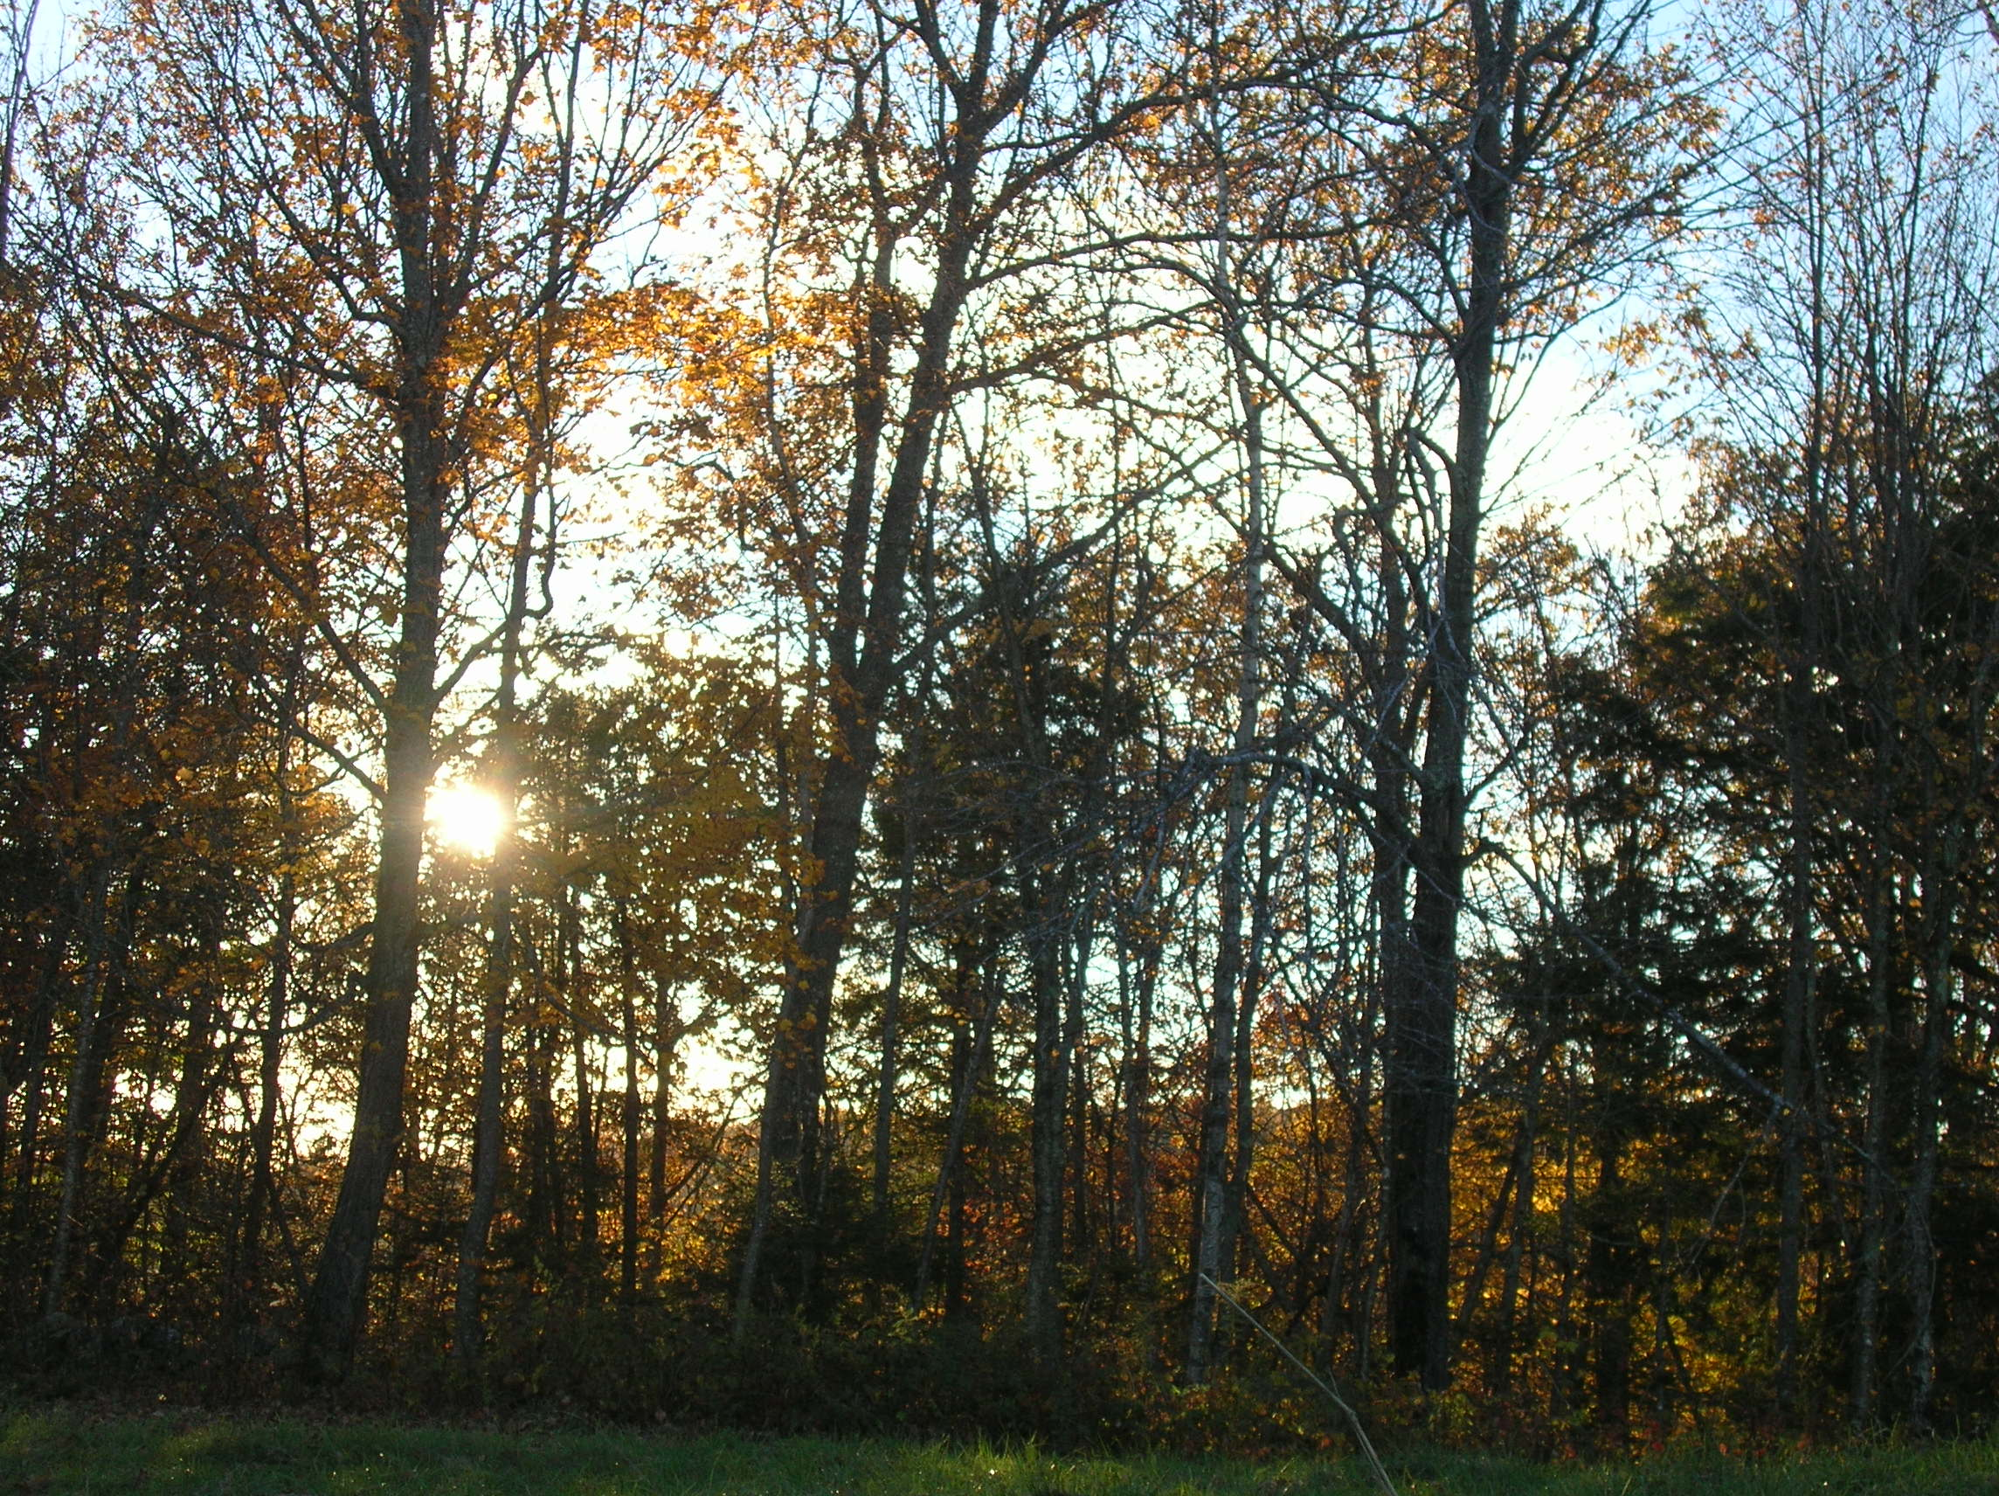
Principle One:
Nature Functions in Wholes
Notes:
Holism is the theory that different aspects of a whole are interconnected – they cannot exist independently of the whole – or cannot be analyzed or understood without reference to the whole.
A Tale of Two Seashores
Sometimes, tinkering with individual parts of a whole system can have dramatic and often disastrous results. An American biologist, Robert Paine, was studying seashores. He wondered what would happen if he removed one species of aquatic life—a starfish—from that environment. This species of starfish was a predator in that community, preying on some 15 or so smaller fish and organisms.
After one year, only half (8) of the original prey species remained. With no predator to control the populations, some of the remaining species grew quickly in number, using up available space and food. Other species were crowded out and either forced to move or died out.
During that same year, in another part of the seashore where the starfishes were still present, all 15 species continued to thrive. The relationship between the predator (starfish) and prey species was maintained.
Refer to the bottom of page – assign each table an example to create. Discuss

Slide 5
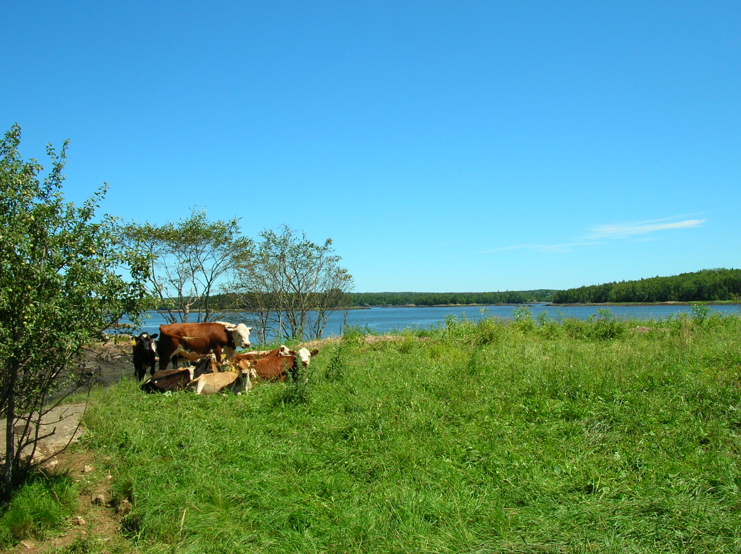
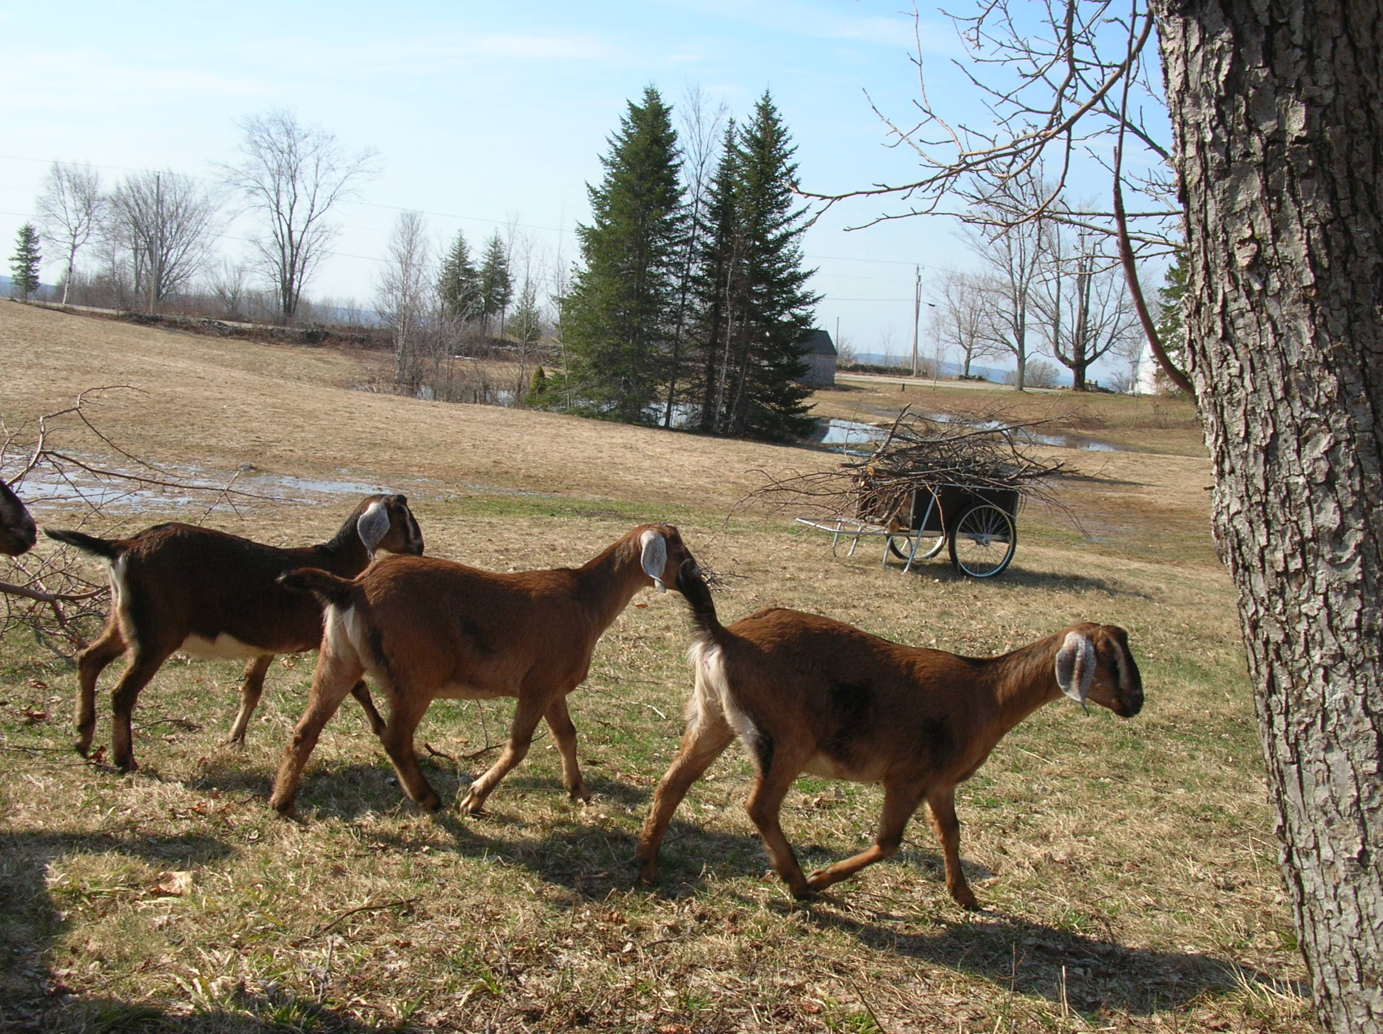
Manage your farm as a whole system
Notes:
Holism is the theory that different aspects of a whole are interconnected – they cannot exist independently of the whole – or cannot be analyzed or understood without reference to the whole.
A Tale of Two Seashores
Sometimes, tinkering with individual parts of a whole system can have dramatic and often disastrous results. An American biologist, Robert Paine, was studying seashores. He wondered what would happen if he removed one species of aquatic life—a starfish—from that environment. This species of starfish was a predator in that community, preying on some 15 or so smaller fish and organisms.
After one year, only half (8) of the original prey species remained. With no predator to control the populations, some of the remaining species grew quickly in number, using up available space and food. Other species were crowded out and either forced to move or died out.
During that same year, in another part of the seashore where the starfishes were still present, all 15 species continued to thrive. The relationship between the predator (starfish) and prey species was maintained.
Refer to the bottom of page – assign each table an example to create. Discuss
5

Slide 6
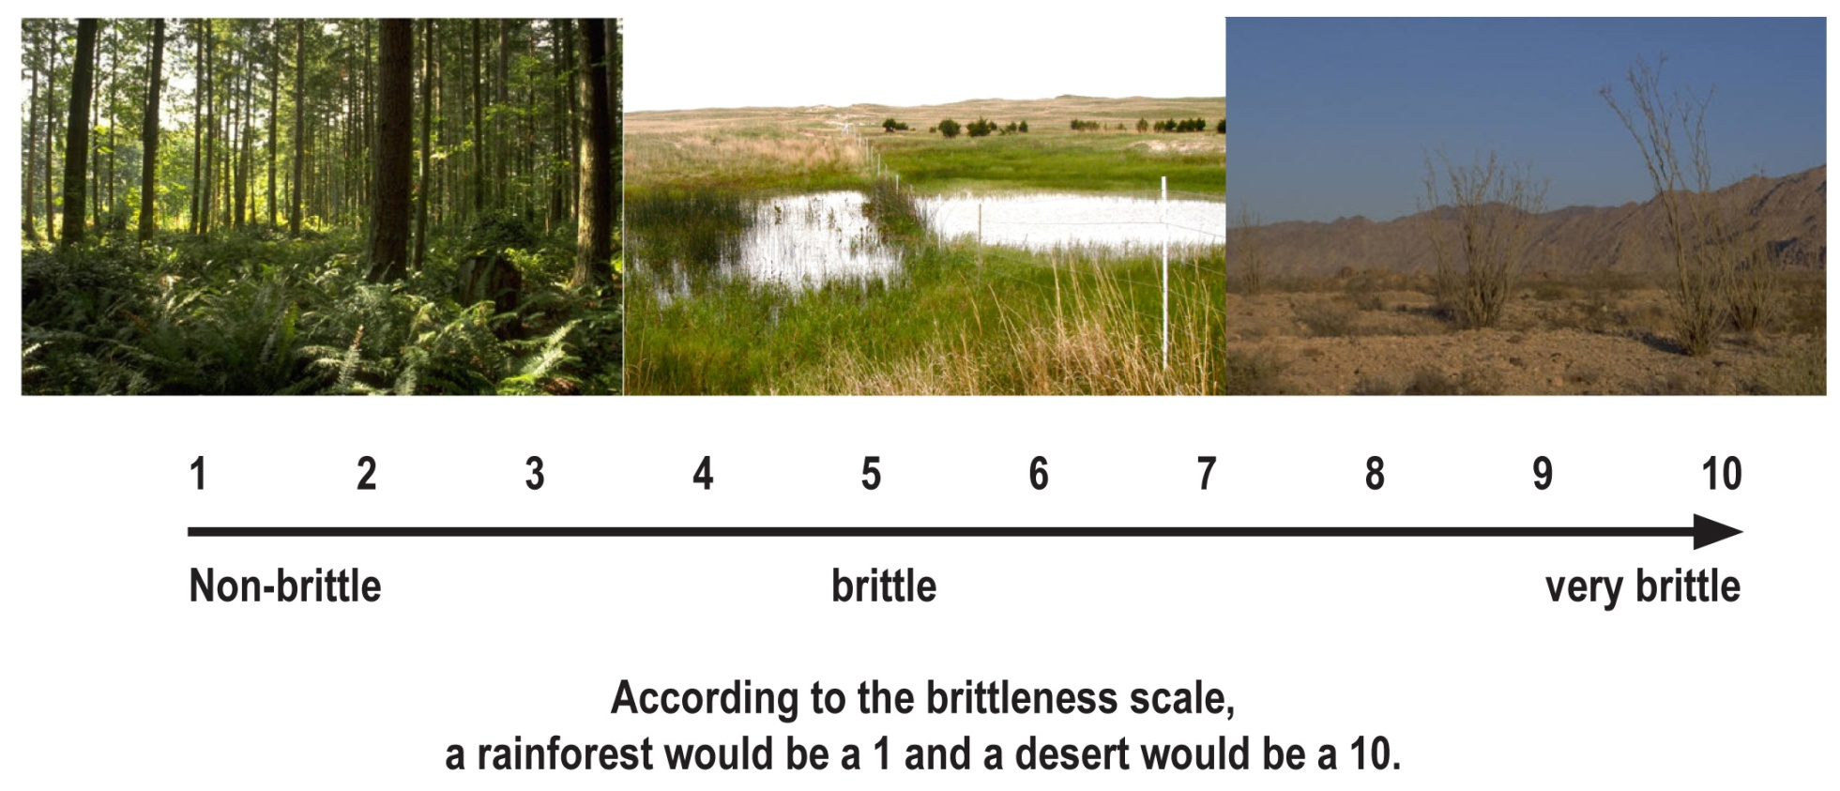
Principle Two:
Understand Your Environment
The Brittleness Scale
Notes:
Describe the importance of brittleness as a concept for understanding your environment.
Environments can exist on different ends of a scale depending on how well moisture is distributed throughout the year and how quickly dead vegetation breaks down.
Discuss slide and the brittleness scale.
Refer group to page 1·6
Think about where you live—the amount of rainfall you get, the level of humidity in the air, and how it is distributed throughout the year. How long does it take vegetation to break down? Do you see moss growing on brick buildings, recently fallen logs partially decayed, living organisms moving about on the soil surface? These are signs of a non-brittle environment.
If you have dead grass, or logs lying around for years without changing much, or just a couple of types of plants with large areas of bare ground -- these indicate a brittle environment.
Exercise page 1·7 run as described in Facilitator Guide

Slide 7
Holistic Management Practices
1. Define what you manage
2. State what you want
3. Aim for healthy soil
4. Consider all tools
5. Test your decisions
6. Monitor your results
Notes:
Show the list of practices quickly, adding to the list by sharing additional information e.g. #1 Define what you manage includes getting clarity on your inventory – those involved in decision making and all your assets (resources)
Comment that we will go into each of these in much greater detail in the order listed.

Slide 8
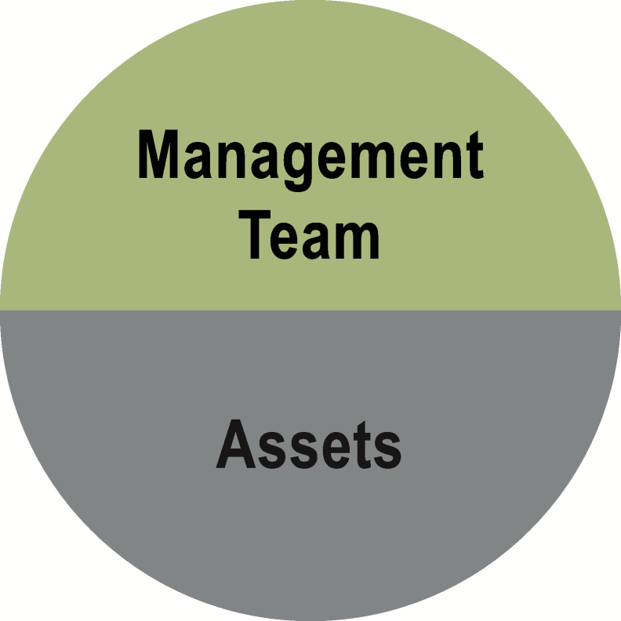
Practice One:
Define What You Manage
You can better manage your assets when you define your management boundaries.
Notes:
In Tab 2 we will spend more time to concentrate on your own Inventory (management team and assets) and your holistic goal
Run activities on pages 2.2

Slide 9
Practice One:
Define What You Manage
Notes:
Defining management boundaries means you are better able to manage your inventory.
Have each person list individuals on their management team.

Slide 10
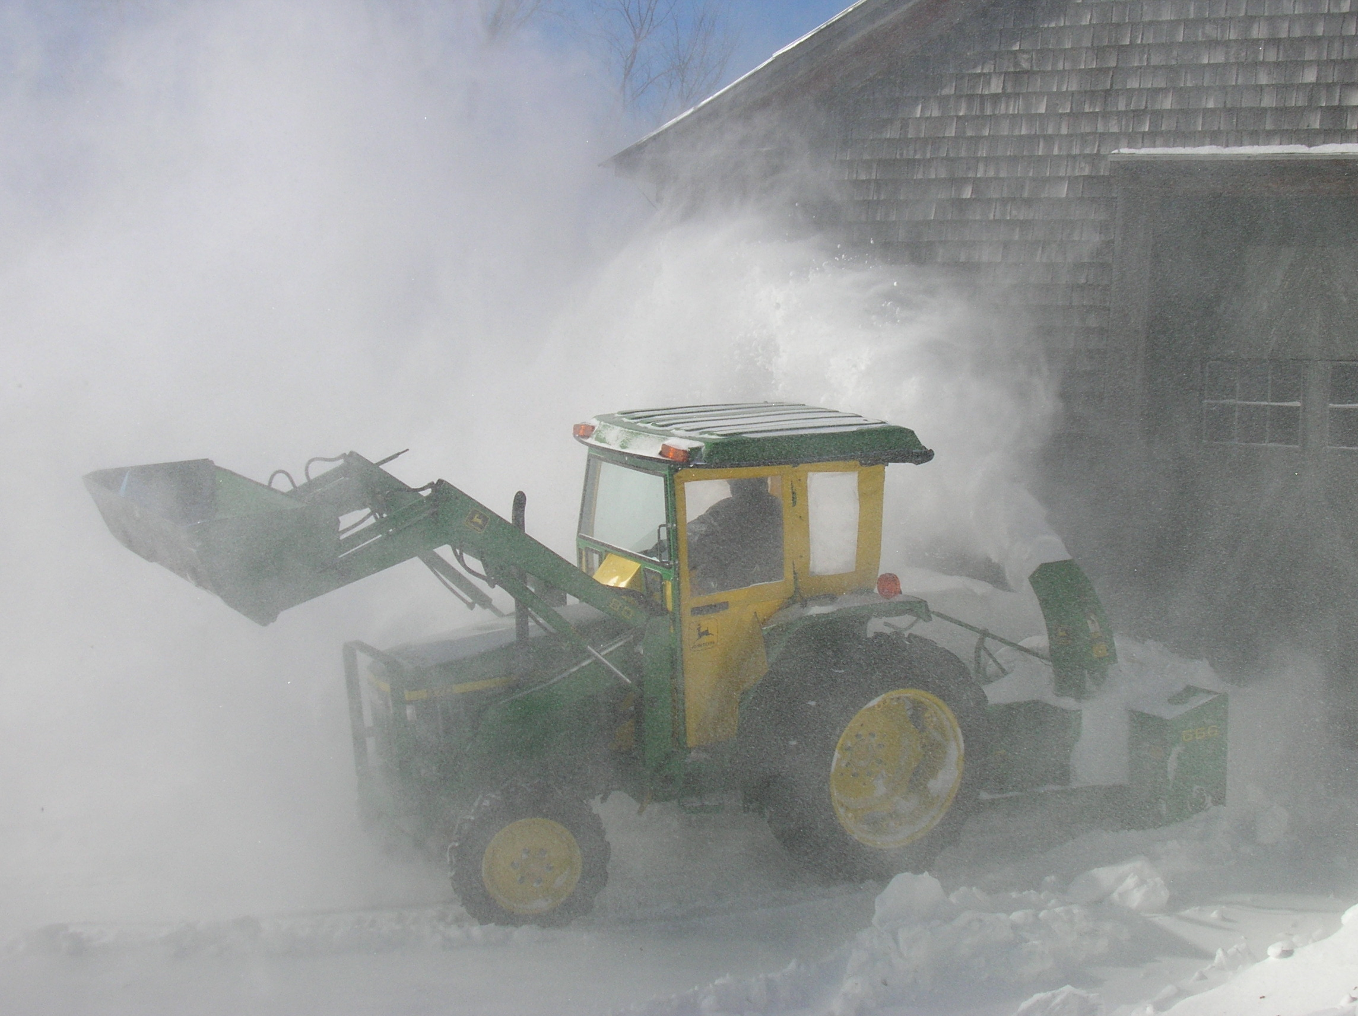
Your Asset Base
Consider all the resources available to you:
  Physical
  Human
  Financial
Notes:
Reference page 2.4 for the exercise

Slide 11

Practice Two:
State What You Want
Elements of the Holistic Goal
  Quality of Life and Values
  Behaviors and Systems
  Future vision
Notes:
To create your holistic goal we will spend time looking at your
Quality of life and values
Behaviors and systems
Vision

Slide 12

Practice Three:
Aim for Healthy Soil
  The Four Ecosystem Processes
Notes:
Introduce the water cycle, mineral cycle, biological community, and energy flow
Note that soil surface is key to retaining moisture in the soil and extending growing time.

Slide 13

Importance of Soil Cover
Importance of soil cover
In the functioning of the water cycle
In the mineral cycle
In biological community and succession
In the flow of energy
Notes:
Ask about the role soil cover plays in each of the ecosystem processes by responding to the questions. Option: assign one question to each of four groups to discuss.

Slide 14
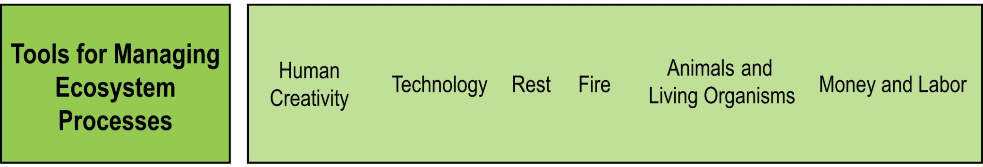
Tools for Managing the Ecosystem
Notes:
The first and last, human creativity and money and labor, are both required in using the other tools. Technology is the primary tool used in urban or industrial businesses.
Few technology tools are intended to modify our ecosystem, although they often do.
In land management, fire, rest, and technology are the most used for modifying our ecosystem. However, the impact from animals and living organisms can help improve land health, water infiltration, and the land’s ability to sequester carbon.
Tools are neither good nor bad and should be managed within the context of your Inventory.
Consider your holistic goal, the degree of brittleness of your environment, and other factors before you decide if tool is suitable.

Slide 15
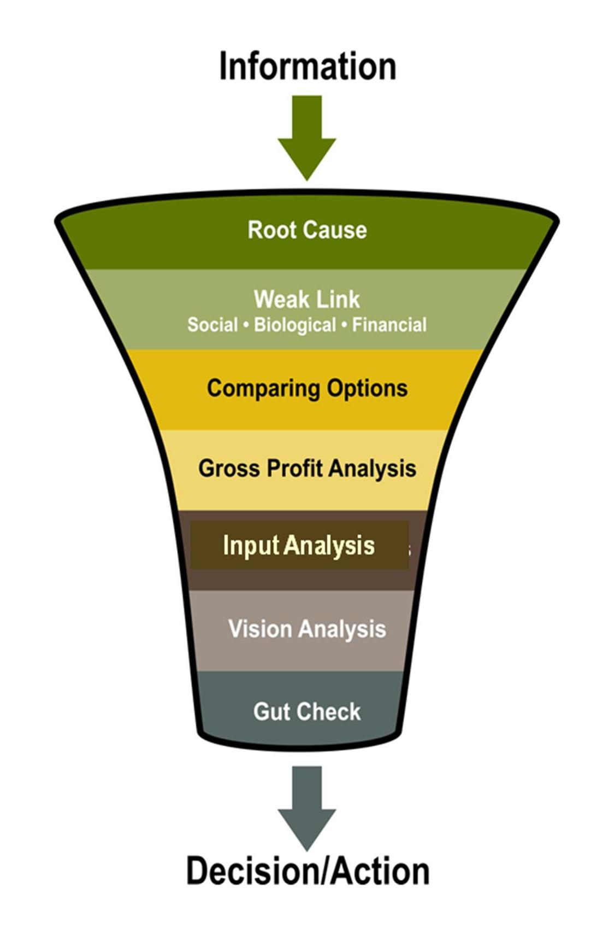
Practice Five:
Testing Your Decisions
Notes:
The seven testing questions help sift through the many factors and complex variables to get to the heart of the matter. Does the action or decision meet the triple bottom line toward your holistic goal?
With practice, testing will become an almost automatic part of your decision-making process to help you create the results you want. In the last tab of this guide is a worksheet you can use to test decisions.
It is difficult to make decisions that consider all three aspects of the triple bottom line: social, financial, and environmental. Some decisions may be economically sound, but are implemented at the expense of the environment or human welfare; others are environmentally sound, but economically unfeasible or harmful to humans. When we are not able to manage for all three aspects, decisions may have undesirable or even disastrous results.
BENEFIT: The testing questions help sift through the variables that are part of making a decision.
These tests supplement other considerations when making a decision (research, gut feelings, intuition, cash flow, etc.). The testing is a check after all the work is complete or can be used to help you explore options.
Use the seven testing questions, in quick succession to see the likely effect of the decision on your inventory. Use them after you exhaust all other means for making the best decision - research, legal concerns, cash flow, peer feedback, advice from a variety of people, past experience, and gut instinct. Make these considerations part of your early information gathering before you make a decision.
The testing questions provide another filter once your information gathering is complete. Weigh your decisions with your and its outcomes in mind.

Slide 16

1. Root Cause
Does this action address the root cause of the problem?
Forces you to identify the underlying issue.
Avoids addressing only symptoms.

Slide 17
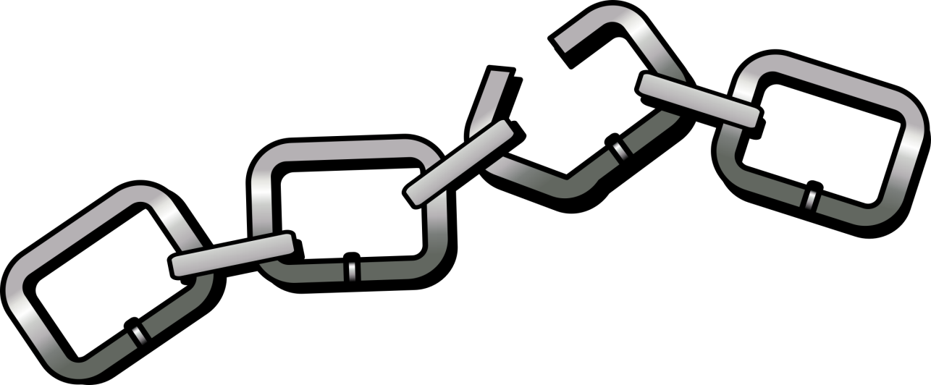
2. Weak Link
Three types
Social
Biological
Financial
Notes:
The weak link test refers to the old adage: a chain is only as strong as its weakest link.
Every chain has a weak link when it is stretched to the breaking point. If you spend time and energy trying to strengthen a chain but don’t address the weak link, you will have wasted resources. Once you’ve identified the weak link in the chain, commit resources to addressing it. The weak link test allows us to check our actions to ensure that they address the link that is weakest at any given moment.
This test applies in three major areas: social, biological, and financial.

Slide 18
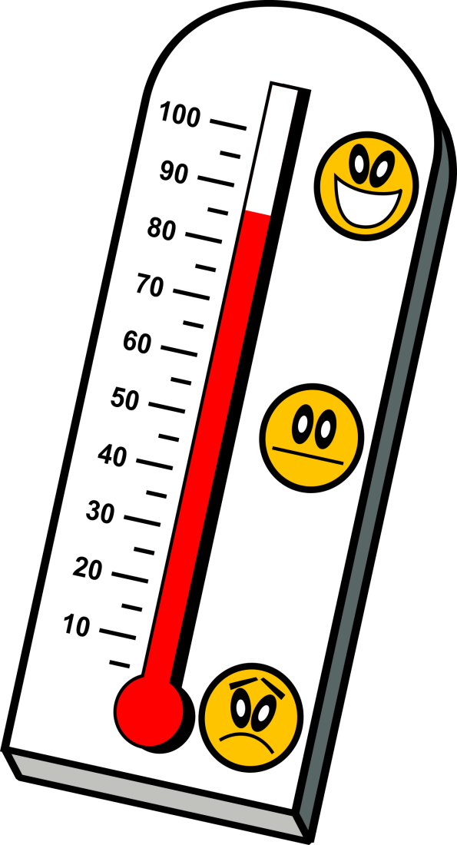
Social Weak Link
Are there any social
concerns regarding this action?
Avoids misunderstandings
or personal obstacles
Notes:
Are there any social concerns regarding this action?
Is it possible that the decision will offend or confuse people
whose support you need? Even if your decision is right,
without support from your management team or those in
your asset base, it will ultimately cause conflict.
BENEFIT: This question helps you win friends and influence people. It is not a pass or fail question. It sends up red flags address before you go ahead. You can then figure out how to avoid misunderstandings or obstacles to get where you want to go.

Slide 19
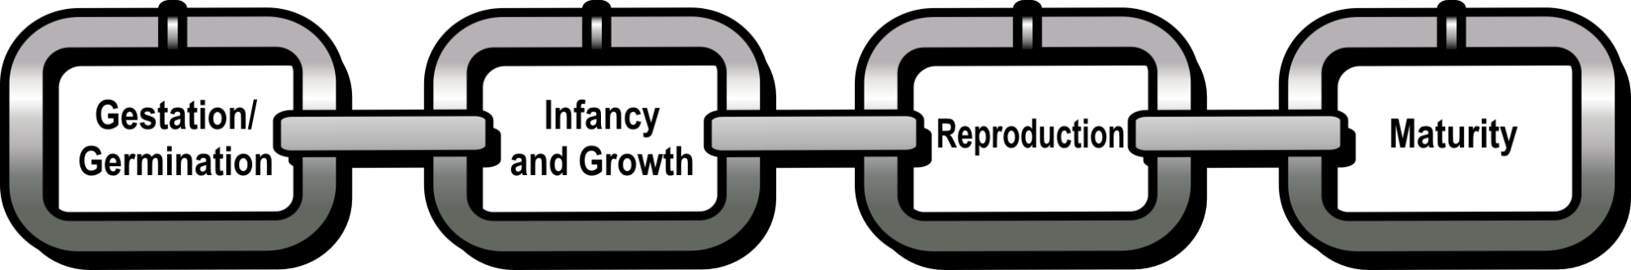
Biological Weak Link
Does this action address the weakest point in the life cycle of this organism?
Notes:
Does this action address the weakest point in the life cycle of this organism?
Use this test when you are dealing with populations of plants or animal organisms that have become a problem. For example, parasites infesting cattle, leafy spurge that’s invaded a grassland, or cockroaches in a kitchen. Or does a rare aloe plant need protection? Is a species of animal life threatened or in danger of extinction?
Every organism has a point of greatest vulnerability during its life cycle—a weak link. By recognizing this vulnerability, your ability increases to effectively, and often less expensively, reduce the numbers of a “problem” organism, or increase the numbers of populations you want to enhance.
Gestation (animals) – Germination (Plants)
Infancy and Growth
rapid development and growth requires significant resources to sustain growth to maturity.
Reproduction
Maturity - After an organism reaches maturity most resources are used to maintain the organism; growth has now mostly ceased.

Slide 20
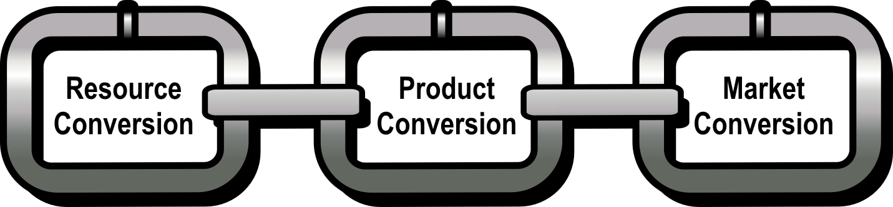
Financial Weak Link
In this enterprise, what single thing will have the greatest impact on your ability to generate income?
By investing funds where they give the greatest return, maximize your return on investment
Notes:
Each year you need to identify the weakest link in the chain of production. Look for the link preventing you from making progress toward your holistic goal. This discussion usually occurs when your team works through yearly holistic management financial planning. Investment in the identified weak link is a wealth-generating expenditure. ROI = return on investment
Does this action address the weakest link in the chain of production? In my enterprise, what single thing will have the greatest impact on my chain of production?
Chain of Production:
Resource conversion - Converting sunlight energy through plants into goods or services.
Product conversion - Converting what you produce into a marketable form.
Market conversion - Selling what you produce to gain money. If you’ve created a great product or service and have difficulty selling it, you have a marketing conversion weak link.
Using the Holistic Management® Financial Planning process you determine your financial weak link—clarifying whether resource conversion, product conversion, or marketing is your weakest link. This test is explored in greater detail in other Holistic Management International programs and in the Holistic Management Handbook.
Determining the weakest link in your chain of production helps you get the greatest return for your money or time and strengthens the entire chain.
KEY POINT: Remember, if you test any other decision it will fail the financial weak link test, if it doesn’t lead you to your short- or long-term solution. Once you determine which link is the weakest, then any expense which helps strengthen it is a wealth-generating expense. The reverse is also true.

Slide 21
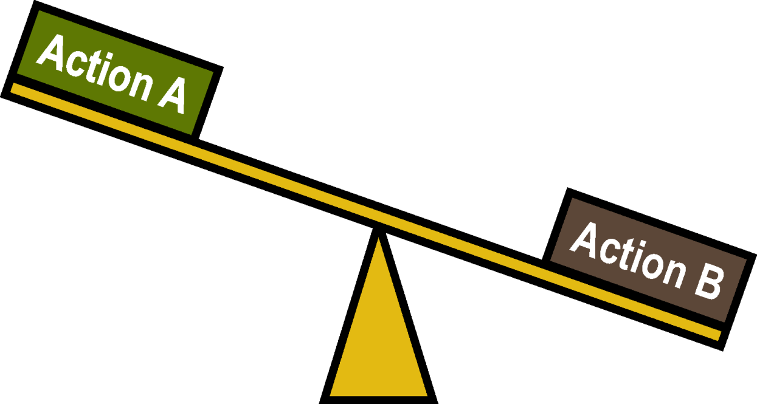
3. Comparing Options
Based on your holistic goal. . .
What is the biggest bang for your buck?
Notes:
Which action gets the biggest bang for the buck toward your holistic goal?
Where is your highest return?
Comparing Options is a test used to compare two or more possible actions and prioritize efforts and expenditures. No two actions will give exactly the same return for the time, money, or physical energy you invest. So, when resources are limited, select the one with the best return toward your holistic goal.
This test helps you decide on the action that provides the greatest return toward your holistic goal.

Slide 22
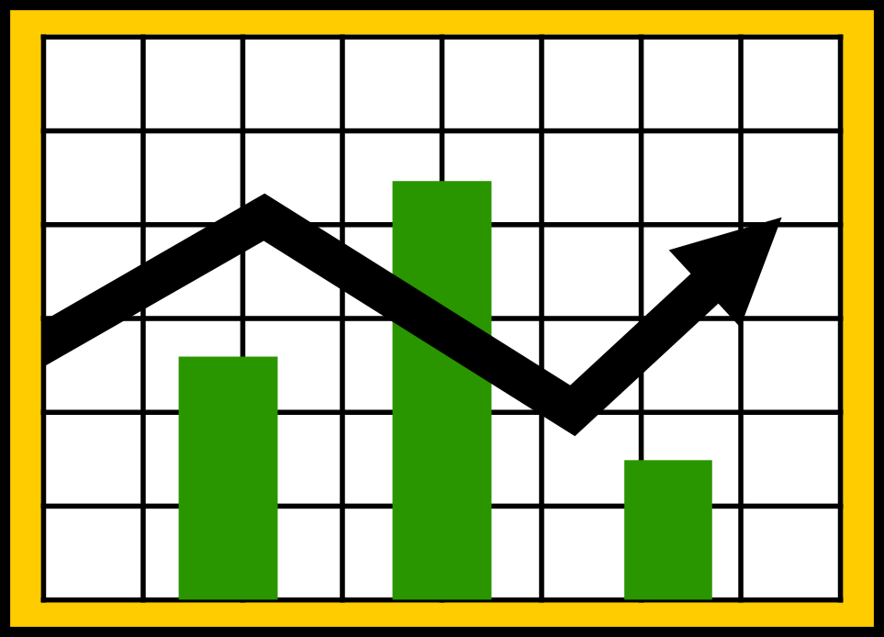
4. Gross Profit Analysis
Which enterprise(s) contribute the most?
Notes:
The gross profit analysis test is used to compare two or more products or services (enterprises). Gross profit is the difference between your income for a product or service and the cost to provide it (before you deduct overhead, payroll, taxes, and interest).
Use gross profit analysis only when comparing two or more enterprises. Which enterprises contribute most to cover fixed costs (overhead) of the business?
Use comparing options analysis for two or more actions.
For a specific enterprise: Gross profit = income – direct costs
After you know the gross profit for each enterprise you are considering, you can evaluate which is likely to be most profitable. The income generated also has to cover more than your overhead, if the business is going to be profitable.
Gross profit analysis is used in the Holistic Financial Planning® process to compare relative profitability. However, only a full financial picture will tell if the enterprise(s) you’ve selected will cover all fixed costs and return a profit. Remember that enterprises that pass this test also need to pass other testing questions to be considered. This test takes more time than the others, but it is time well spent, before you consider new enterprises.
BENEFITS:
To see which enterprises produce the most income for the least additional cost.
To compare potential risk of these enterprises.

Slide 23
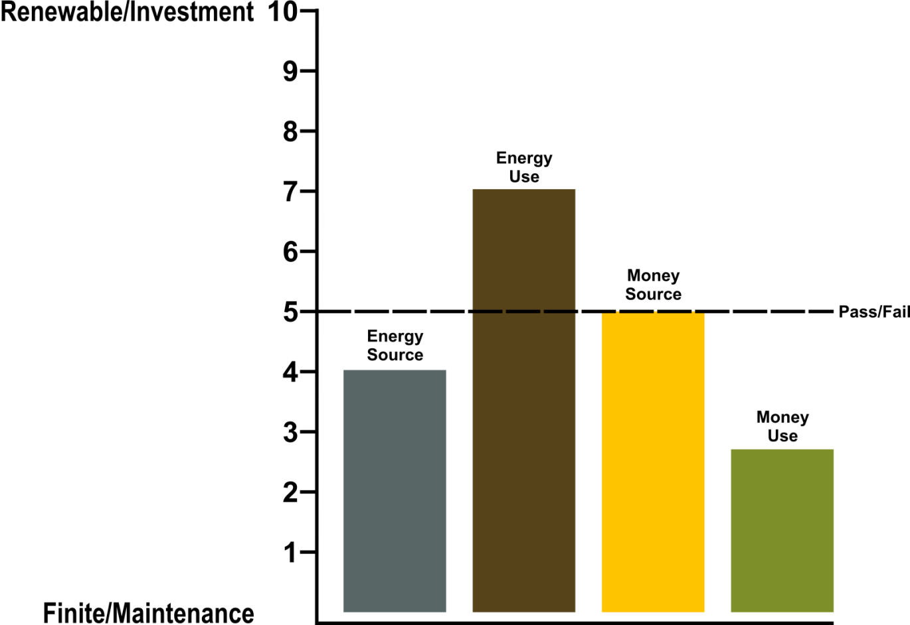
5. Input Analysis
Notes:
This test considers whether the potential investment of energy and money is sustainable. You consider both energy and money because any action you contemplate will require one or both. These actions must also pass the seven testing questions.
ENERGY sources fall into categories:
Abundant/unlimited or limited in supply.
Solar energy that is used to grow crops is unlimited. However, gas or other petroleum-based fuels used for farm machinery are not.
Benign or potentially damaging to the environment.
The environmental impact of energy sources depends on the rate at which they are consumed and the methods used to harness and distribute them.
When you choose to walk or ride a bike instead of driving, you are choosing a benign source of energy. So is a farmer who uses livestock to break down corn stubble in a field rather than machinery.
MONEY can come from either internal or external sources. Consider strings attached to money from outside sources.
ENERGY-MONEY USE: Look at your investment in the way you use energy and money. Does it take you in the direction of your holistic goal? Energy and money that are used to build infrastructure (buildings, machinery, fencing, transport, trained staff, a specific knowledge base, etc.) are preferable, as are uses for a one-time investment that will sustain itself. Avoid uses with no lasting effect or where you risk dependence.
BENEFIT: Investment analysis encourages you to consider how to solve the problem using renewable sources and to weigh your options carefully, looking for sustainable investments.

Slide 24
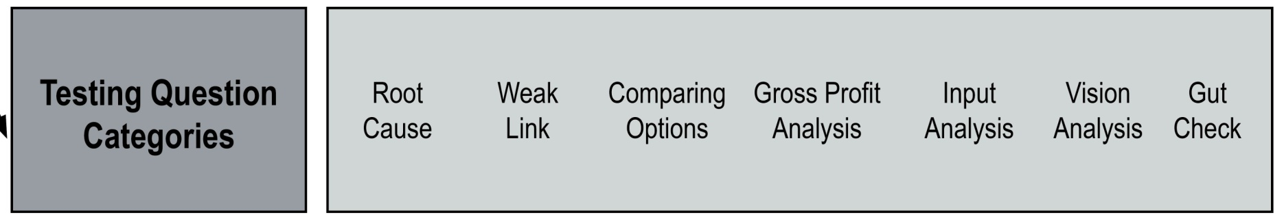
6. Vision Analysis
Will this decision bring you closer to your future vision in your holistic goal?
Notes:
Does this action lead toward or away from the vision in your holistic goal?
This question helps you keep in mind the long-term consequences of your actions and behavior.
The vision analysis requires you to look at what you think must be in place far into the future to sustain you and to consider whether the decision or action will move you in the direction you need.

Slide 25

7. Gut Check
Does the decision feel right?
Notes:
The gut check asks how you feel about the action or decision, not what you think. No question carries more weight.
An action or decision may:
Pass all other tests, but you may choose not to do it because it doesn’t feel right.
Not pass the majority of testing questions, but you still feel it is the right thing to do. Then, you can work to mitigate the consequences and better identify what to monitor.
Use this test with your management team members who have ownership in the holistic goal. This decision is based on your own cultural and social values and traditions.
This question processes all the information you have analyzed in the other six tests, bearing in mind the quality of life you’ve described in your holistic goal.

Slide 26
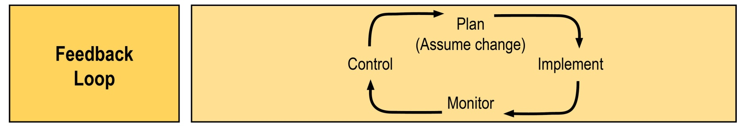
Monitoring Your Decision
Lets you quickly know
if your plan has gone off track.
Notes:
The Feedback Loop
Before you begin to implement a decision, consider any unintended consequences that could arise from your actions.
Determine the earliest warning signs that might say you’re going off track. Monitor those indicators carefully; take action if things start to go wrong.
If you find you’re headed someplace you didn’t want to go, either adjust your plan or re-plan.
Decision monitoring helps ensure that if your plan goes off track, you don’t go very far before doing something about it.
Use the decision Testing Matrix in Tab Five to help you remember and use the testing questions.

Slide 27
Holistic Management Decision Testing Matrix
Proposed Action: | Pass | Fail | Doesn’t Apply | Don’t Know | Notes
Root Cause
Weak Link – Social
Weak Link – Biological
Weak Link – Financial
Comparing Options
Gross Profit Analysis
Input Analysis
Vision Analysis
Decision:

Slide 28
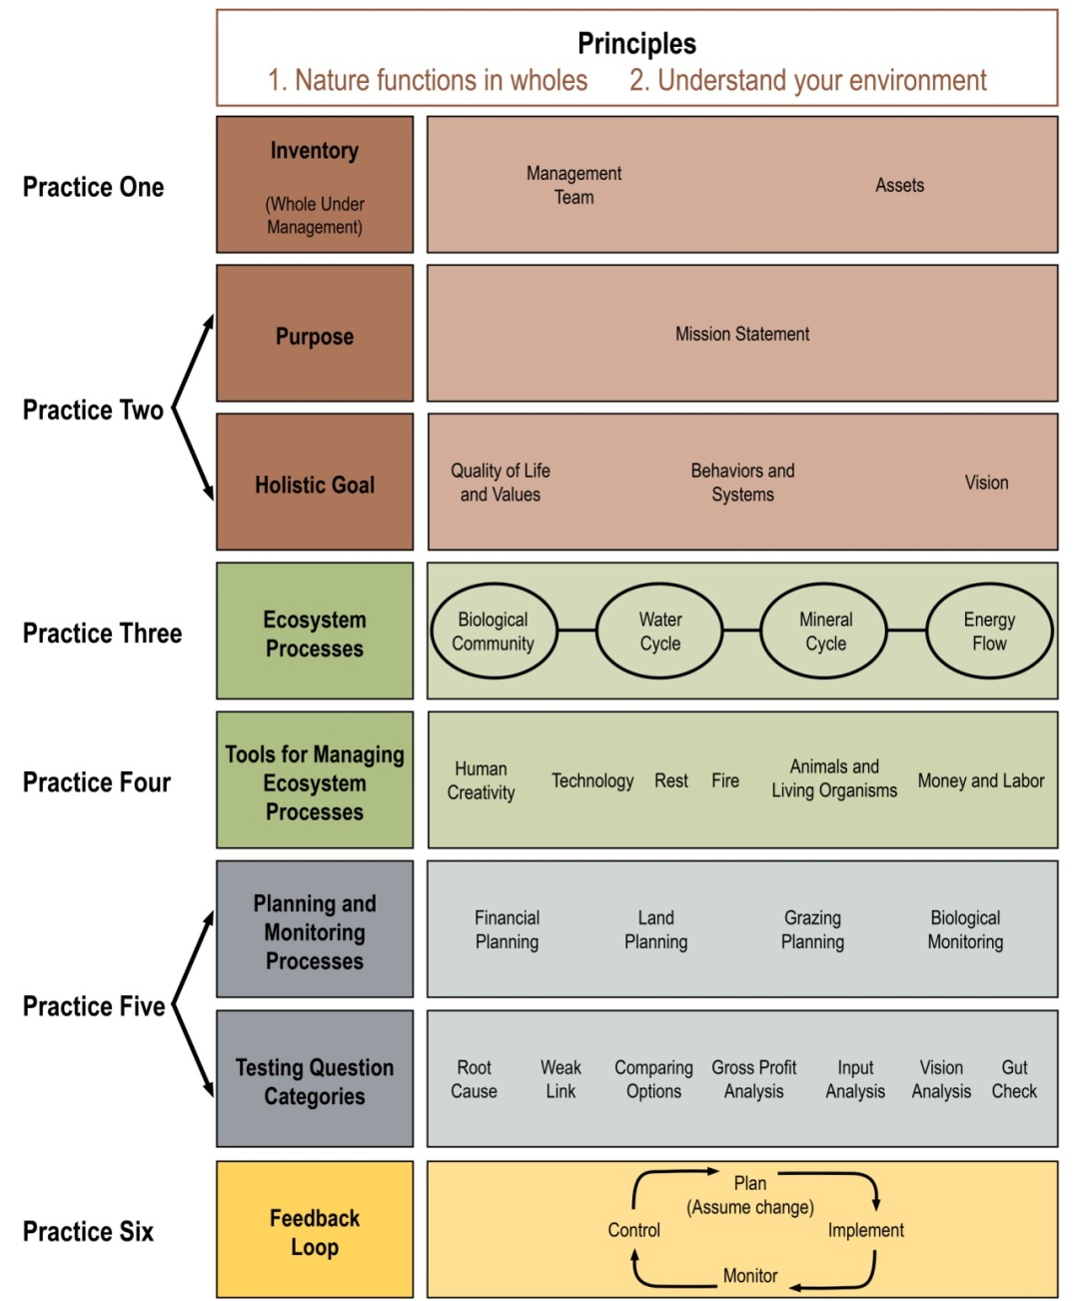
Holistic Management Framework
Notes:
The Feedback Loop
Before you begin to implement a decision, consider any unintended consequences that could arise from your actions.
Determine the earliest warning signs that might say you’re going off track. Monitor those indicators carefully; take action if things start to go wrong.
If you find you’re headed someplace you didn’t want to go, either adjust your plan or re-plan.
Decision monitoring helps ensure that if your plan goes off track, you don’t go very far before doing something about it.
Use the decision Testing Matrix in Tab Five to help you remember and use the testing questions.

Slide 29
In conclusion
Holistic Management® is a whole farm planning system designed to help you
Make good decisions
Plan for profit
Stay true to your personal goals
For more information: go to
holisticmanagement.org/
Notes:
The Feedback Loop
Before you begin to implement a decision, consider any unintended consequences that could arise from your actions.
Determine the earliest warning signs that might say you’re going off track. Monitor those indicators carefully; take action if things start to go wrong.
If you find you’re headed someplace you didn’t want to go, either adjust your plan or re-plan.
Decision monitoring helps ensure that if your plan goes off track, you don’t go very far before doing something about it.
Use the decision Testing Matrix in Tab Five to help you remember and use the testing questions.
29

